Slide 1
Lecture 6
Data aggregation

Slide 2
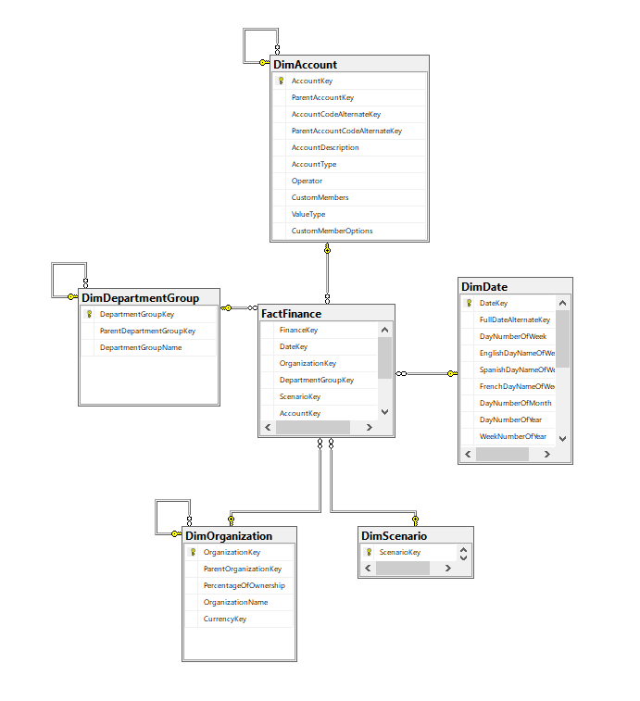
Database scheme

Slide 3
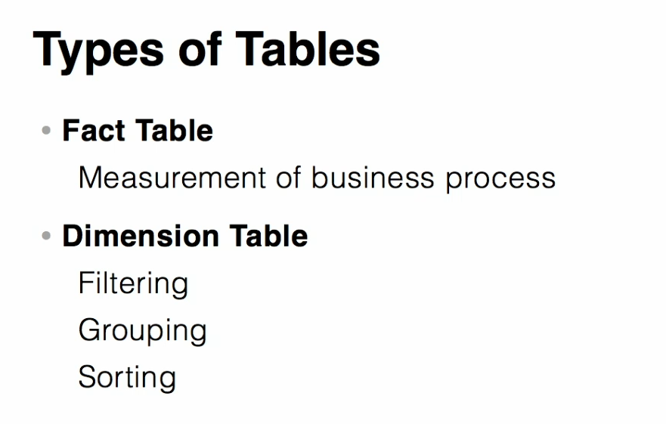
Types of tables

Slide 4
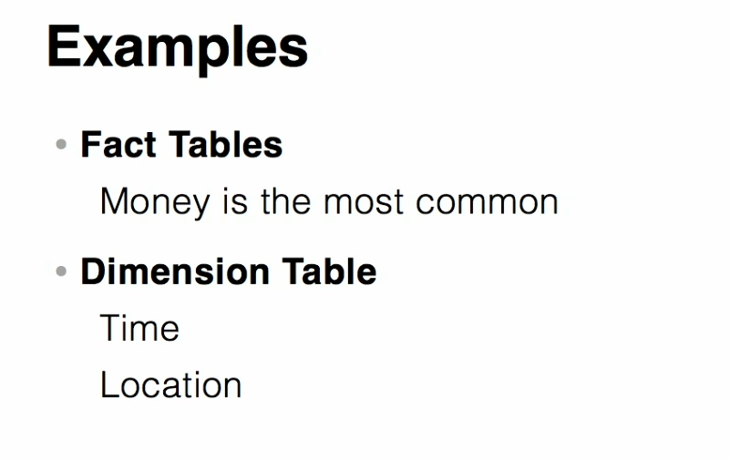
Types of tables

Slide 5
Creating a view to get more information
CREATE VIEW [dbo].[Total_DimTerritoryAndGeography]
AS
SELECT dbo.DimGeography.City,
dbo.DimGeography.StateProvinceCode,
dbo.DimGeography.StateProvinceName,
dbo.DimGeography.CountryRegionCode,
dbo.DimGeography.EnglishCountryRegionName,
dbo.DimSalesTerritory.SalesTerritoryGroup,
dbo.DimSalesTerritory.SalesTerritoryRegion
FROM dbo.DimGeography INNER JOIN
dbo.DimSalesTerritory ON dbo.DimGeography.SalesTerritoryKey = dbo.DimSalesTerritory.SalesTerritoryKey

Slide 6
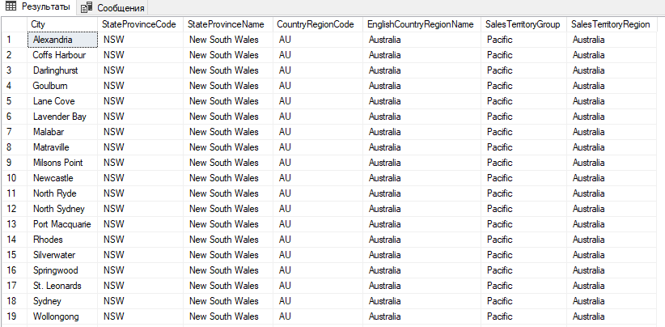
Creating a view to get more information

Slide 7
Creating a view with group by
CREATE VIEW [dbo].[Total_FactInternetSales] AS SELECT SUM(DiscountAmount) AS Total_DiscountAmount, SUM(ProductStandardCost) AS Total_ProductStandardCost, SUM(TotalProductCost) AS Total_TotalProductCost, SUM(SalesAmount) AS Total_SalesAmount, OrderDate, CustomerKey, CurrencyKey FROM dbo.FactInternetSales GROUP BY OrderDate, CustomerKey, CurrencyKey

Slide 8
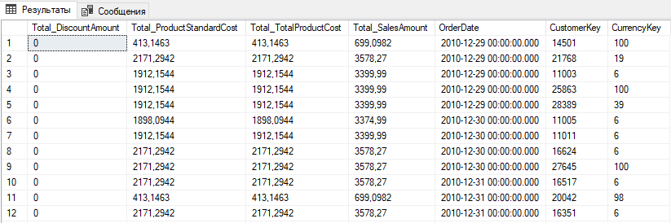
Creating a view with group by

Slide 9
Create relationship between view and schema
ALTER VIEW [dbo].[Total_FactInternetSales] WITH SCHEMABINDING AS SELECT SUM(DiscountAmount) AS Total_DiscountAmount, SUM(ProductStandardCost) AS Total_ProductStandardCost, SUM(TotalProductCost) AS Total_TotalProductCost, SUM(SalesAmount) AS Total_SalesAmount, OrderDate, CustomerKey, CurrencyKey, COUNT_BIG(*) as RecordCount FROM dbo.FactInternetSales GROUP BY OrderDate, CustomerKey, CurrencyKey

Slide 10
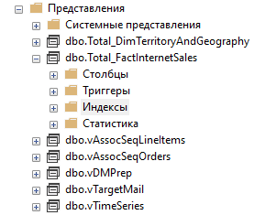
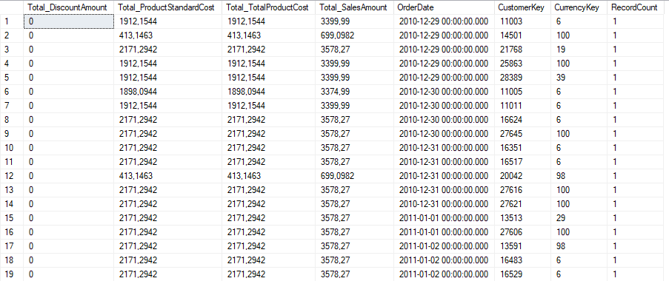
Creating an index
CREATE UNIQUE CLUSTERED INDEX [IX_Total_FactInternetSales] ON [dbo].[Total_FactInternetSales] (OrderDate, CustomerKey, CurrencyKey)

